Slide 1
Intercultural Communication
Unit 2
Communication
and
Culture

Slide 2
Communication
CONTEXT
CONTEXT
Noise
Sender
Encoding
Message
Channel
Receiver
Decoding
Receiver
Response
Feedback

Slide 3
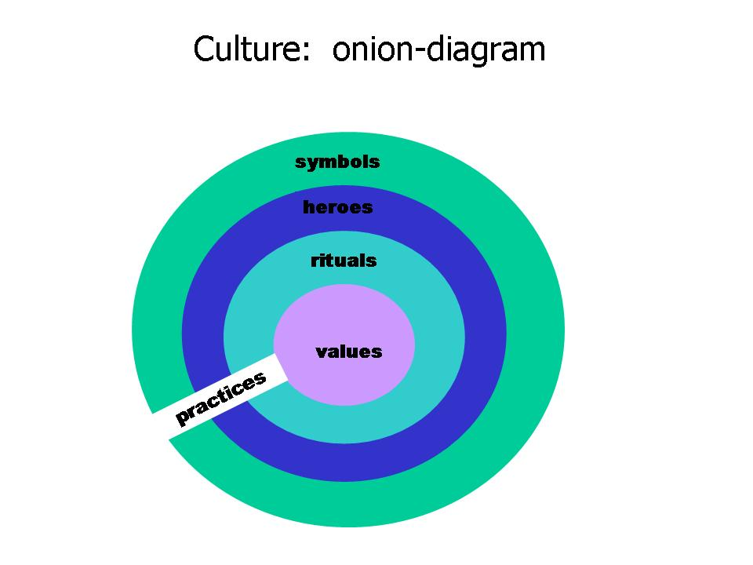
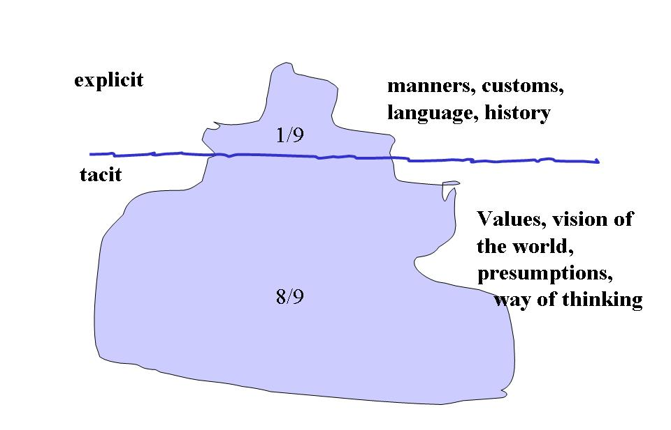
Culture and Its Components

Slide 4
Communication & Culture
“Culture is communication and communication is culture.” ---Edward T. Hall
1. Culture is everything and everywhere.
2. Culture is both teacher and textbook.
3. Communication and culture are inseparable and culture is the foundation of communication.
4. It is through communication that culture is passed down, created, and modified from one generation to the next. And culture also affects communication. It has influence on the ways and results of communication.

Slide 5
Functions of Culture
3
4
Intergroup boundary regulation
Ecological adaptation
2
Group inclusion
5
Cultural communication
Identity meaning
1

Slide 6

Ethnocentrism: our tendency to consider our own cultural practices as superior and consider other cultural practices as inferior

Slide 7
Part Three Exercises
Section A Culture Quiz
1. Watch the video Collectivism-Individualism Through Dance to learn some differences between me-culture and we-culture and fill in the following blanks, and then explain why the student and the teacher have their different opinions on the same answer in the exam.
Me-culture means individualistic culture which plays individual first. People from individualistic cultures like the United States and Western Europe are more likely to value uniqueness over harmony, expression over agreement, and to define themselves as unique or different from the group.
We-culture means collectivist culture which plays group first. People from collectivist cultures are more likely to value social harmony over individuality. Relative to people in an individualistic culture, they are more likely to endorse behaviors that increase group cohesion and interdependence.

